Slide 1
factors driving home prices
Presented by James Guffogg
Presented to Jay Padhya
02/26/2023

Slide 2
Goals of this presentation
Explore factors that drive home prices.
To understand how to allocate dollars that are earmarked for investment into mortgage-backed securities (MBS).

Slide 3
Introduction
So, what is a Mortgage-Backed security?
“Mortgage-backed securities (MBS) are investment products similar to bonds. Each MBS consists of a bundle of home loans and other real estate debt bought from the banks that issued them. Investors in mortgage-backed securities receive periodic payments similar to bond coupon payments.” (Investopedia, 2023)
The success of the process very much depends on the issuers ability to identify solid investments to include. In this case, we want to assess how different factors weigh on the sale price of homes.
Factors that will be considered in this analysis include;
Overall quality (scale of 1-10)
Year built
Total basement Sq. Ft
Kitchen quality
Garage cars (car capacity of the garage)

Slide 4
hypotheses
Overall Quality
Null: There is no significant difference between the overall quality (IV) of the home and the sale price (DV). Ho: μ1 - μ2 = 0.
Alternate: There is a significant difference between the overall quality (IV) of the home and the sale price (IV). Ha: μ1 - μ2 ≠ 0
Year Built
Null: There is no significant difference between the year that the house is built (IV) and the sale price (DV). Ho: μ1 - μ2 = 0.
Alternate: There is a significant difference between the year the house is built (IV) and the sale price (DV). Ha: μ1 - μ2 ≠ 0
Total Basement Sq. Ft
Null: There is no significant difference between the total basement sq. ft (IV) and the sale price (DV). Ho: μ1 - μ2 = 0.
Alternate: There is a significant difference between the total basement sq. ft. (IV) and the sale price (DV). Ha: μ1 - μ2 ≠ 0
Kitchen Quality
Null: There is no significant difference between the kitchen quality (IV) and the sale price (DV). Ho: μ1 - μ2 = 0.
Alternate: There is a significant difference between the kitchen quality (IV) and the sale price (DV). Ha: μ1 - μ2 ≠ 0
Garage Cars
Null: There is no significant difference between the garage cars (IV) and the sale price (DV). Ho: μ1 - μ2 = 0.
Alternate: There is a significant difference between the garage cars (IV) and the sale price (DV). Ha: μ1 - μ2 ≠ 0

Slide 5
About the data
For this analysis, the data set was a sample of 1460 residential homes in Ames, Iowa, sold between 2006 and 2010.
There were 81 columns in the data set describing each home, a mix of categorical and continuous variables.
Original Data Source
Descriptive stats for Sale Price are below. Sale price is the dependent variable for this analysis.
Mean | $180,921
Standard Error | $2,079
Median | $163,000
Mode | $140,000
Range | $720,100
Minimum | $34,900
Maximum | $755,000
Count | 1460

Slide 6
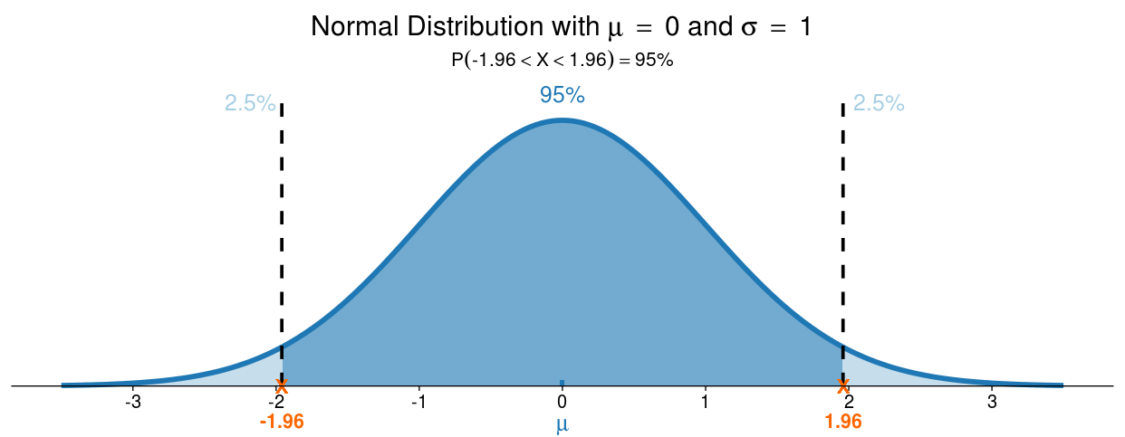
methods
This analysis was done in Excel utilizing pivot tables and the Data Analysis ToolPak. Descriptive statistics (mean, median, etc) and inferential statistics (t-tests) were used.
T-tests – Two sample assuming unequal variance were run on each of the variables to assess their influence on the sale price.
Alpha (ɑ) for 95% confidence is 5% or 0.05. All t-tests executed were set with ɑ at 0.05. Any value that falls outside the confidence level (below ɑ) suggests that there is a significant difference between means.
P values were all taken from Two-tail results.
Why two-tail? It looks for a relationship in both directions.
A two-tailed test allots half of the alpha (2.5%) to test the statistical significance in one direction, and the other half of your alpha (2.5%) to test statistical significance in the other direction.
All column charts show confidence intervals. They’re calculated by multiplying the standard error by the t Critical two-tail value. The standard error is calculated by the SQRT of the variance divided by the observations.
Confidence interval is so called because we assign a specified level of confidence (95% being the most common) that a given range likely contains the population mean.
t-Test: Two-Sample Assuming Unequal Variances
 | >5 | <=5
Mean | 213182.5325 | 125633.1803
Variance | 6609906283 | 960961515
Observations | 922 | 538
Hypothesized Mean Difference | 0
df | 1299
t Stat | 29.2559096
P(T<=t) one-tail | 2.9591E-145
t Critical one-tail | 1.646027501
P(T<=t) two-tail | 5.9183E-145
t Critical two-tail | 1.961791887
Variables were split into two samples using Excel’s pivot table function. The data output for Overall Quality is shown above.
 | OverallQual >5 | OverallQual <=5
Mean | 213182.53 | 125633.18
Variance | 6609906283 | 960961515
Observations | 922 | 538
Standard Error | 2677.516714 | 1336.47814
length c.i. | 5252.730567 | 2621.891973
length c.i. | 5252.730567 | 2621.891973

Slide 7
Results – overall quality
Rates the overall material and finish of the house. On a scale of 1-10.
Homes were split into >5 and <=5.
Ho – There is no significant difference between the overall quality and sale price.
We can reject the null hypothesis at 95% confidence levels, p-value < 5.9183E-145.
P value is displayed in scientific notation. Value is equivalent to 145 zeros after the decimal point.
The confidence intervals (c.i.) displayed on the column chart don’t intersect, further cementing a significant difference in sample means, and supporting the result of the t-test.
t-Test: Two-Sample Assuming Unequal Variances
 | >5 | <=5
Mean | 213182.5325 | 125633.1803
Variance | 6609906283 | 960961515
Observations | 922 | 538
Hypothesized Mean Difference | 0
df | 1299
t Stat | 29.2559096
P(T<=t) one-tail | 2.9591E-145
t Critical one-tail | 1.646027501
P(T<=t) two-tail | 5.9183E-145
t Critical two-tail | 1.961791887

Slide 8
Year Built
Original construction date.
The year built were split into two groups, >2000 and <=2000.
Ho – There is no significant difference between the year built and the sale price.
We can reject the null hypothesis at 95% confidence, p-value 5.11598E-54.
P value is displayed in scientific notation. Value is equivalent to 54 zeros after the decimal point.
The confidence intervals (c.i.) displayed on the column chart don’t intersect, further cementing a significant difference in sample means, and supporting the result of the t-test.
t-Test: Two-Sample Assuming Unequal Variances
 | >2000 | <=2000
Mean | 244527.46 | 159796.49
Variance | 7146040398.96 | 4248538489
Observations | 364 | 1096
Hypothesized Mean Difference | 0
df | 514
t Stat | 17.47554803
P(T<=t) one-tail | 2.55799E-54
t Critical one-tail | 1.647823541
P(T<=t) two-tail | 5.11598E-54
t Critical two-tail | 1.96459

Slide 9
Garage cars
Size of garage in car capacity
The garage capacities were split into two groups, >=2 and <2000.
Ho – There is no significant difference between the garage capacities and the sale price.
We can reject the null hypothesis at 95% confidence, p-value 1.7972E-137
P value is displayed in scientific notation. Value is equivalent to 137 zeros after the decimal point.
The confidence intervals (c.i.) displayed on the column chart don’t intersect, further cementing a significant difference in sample means, and supporting the result of the t-test.
t-Test: Two-Sample Assuming Unequal Variances
 | >=2 Car Garage | <2 Car Garage
Mean | 206436.8198 | 123652.7956
Variance | 6548205456 | 1040897864
Observations | 1010 | 450
Hypothesized Mean Difference | 0
df | 1444
t Stat | 27.91207486
P(T<=t) one-tail | 8.986E-138
t Critical one-tail | 1.64590955
P(T<=t) two-tail | 1.7972E-137
t Critical two-tail | 1.961608186

Slide 10
Total basement sq. ft.
Total square feet of the basement area.
The basement areas were split into two groups, >=1500 and <1500.
Ho – There is no significant difference between the total basement area and the sale price.
We can reject the null hypothesis at 95% confidence, p-value 1.35566E-38
P value is displayed in scientific notation. Value is equivalent to 38 zeros after the decimal point.
The confidence intervals (c.i.) displayed on the column chart don’t intersect, further cementing a significant difference in sample means, and supporting the result of the t-test.
t-Test: Two-Sample Assuming Unequal Variances
 | >=1500 | <1500
Mean | 284759.2732 | 163959.5976
Variance | 11298787421 | 3454162250
Observations | 205 | 1255
Hypothesized Mean Difference | 0
df | 225
t Stat | 15.87980602
P(T<=t) one-tail | 6.77832E-39
t Critical one-tail | 1.651654074
P(T<=t) two-tail | 1.35566E-38
t Critical two-tail | 1.97056339

Slide 11
Kitchen quality
Quality of the kitchen installed
The kitchen qualities were split into two groups, excellent/good and fair/typical average.
Ho – There is no significant difference between the kitchen quality and the sale price.
We can reject the null hypothesis at 95% confidence, p-value 1.3101E-109.
P value is displayed in scientific notation. Value is equivalent to 109 zeros after the decimal point.
The confidence intervals (c.i.) displayed on the column chart don’t intersect, further cementing a significant difference in sample means, and supporting the result of the t-test.
t-Test: Two-Sample Assuming Unequal Variances
 | Excellent, Good | Fair, Typical/Average
Mean | 229089.5875 | 138229.314
Variance | 7302198923 | 1557001442
Observations | 686 | 774
Hypothesized Mean Difference | 0
df | 939
t Stat | 25.54005225
P(T<=t) one-tail | 5.6505E-110
t Critical one-tail | 1.646477996
P(T<=t) two-tail | 1.1301E-109
t Critical two-tail | 1.962493569

Slide 12
Recommendation
Based on the data, I recommend the factors to be considered when allocating dollars are;
Overall quality > 5
Year built > 2000
Car garage >= 2 vehicles
Total basement Sq. Ft. >= 1500 sq ft
Kitchen quality is Excellent or Good.
All of the above variables significantly affected the sale price of homes. p < 0.05.

Slide 13
Discussion
Factors that can enhance our decision-making;
Data on sentiment towards MBS during an economic slowdown.
Data on investor sentiment towards MBS in a rising interest rate environment.
How risk averse is the investor? Can we create various investment packages based on varying risk tolerances?
How do we respond when borrowers (homeowners) refinance or pay off their mortgage early?

Slide 14
additional areas to explore

